Slide 1
ATM Definition
Asynchronous Transfer Mode (ATM)
A high-performance, cell-oriented switching and multiplexing technology that utilizes fixed-length packets to carry different types of traffic.

Slide 2
ATM Overview
ATM:
ATM was designed in early 1990s
In October 1991, ATM Forum with four companies as members– Adaptive (NET), CISCO, Norther Telecom, and Sprint. Since then, ATM Forum members has grown to over 200 principal members.
ATM aim is to expedite the process of integrating AMT into the market.
It is designed for high-performance multimedia networking.
It enables carriers to transmit voice, video, and future media applications.
It’s suitable for bursty traffic.
It allows communication between devices that operate at different speeds.
It can be offered as an end-user service by service providers, or as a networking infrastructure
It is a set of international interface and signaling standards defined by ITU-T Standards Sector.

Slide 3
ATM Features
Main features of ATM
Service is connection oriented, with data transferred over a VC
A cell-switched network (architecture).
Fixed-size cell (53-Bytes)
Uses Asynchronous time-division multiplexing (Asynchronous TDM)
The Quantity of Service (QofS) enable carriers to transmit voice, data, and video.
ATM is independent of the transmission medium. ATM cells can be sent on a wire or fiber, and can also be packaged inside the payload of other carrier system.

Slide 4
Fixed and Small Size Cell
Advantage:
Transmitted with predictability and uniformity.
Easy to be multiplexed with other cells, and routed through the cell network.
With high speed of the links, small and fixed-size cells seem to arrive their respective destinations in an approximation of continuous stream, despite interleaving. E.g. phone call.
Simpler buffer hardware, avoiding memory fragmentation problem
Simpler cells scheduling:
- Easier to allocate different bandwidths and delays to different VCs.
- Easier to implement priority
- Fixed sized can be switched in parallel in synchronous fashion.
It’s suitable for time-critical information such as voice or video
Quicker recovery in case of circuit failure.

Slide 5
Fixed-Size and Small Cell
Disadvantage:
Processing overhead as messages are segmented into cells
Segmentation mismatch, as the last cell in a fragmented message may not be fully used. This effect will decrease as the message length increases.

Slide 6
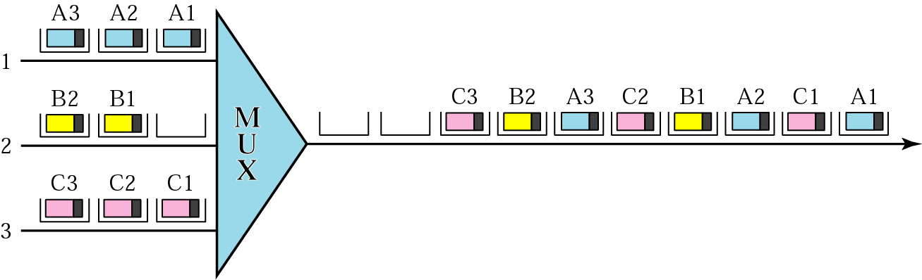
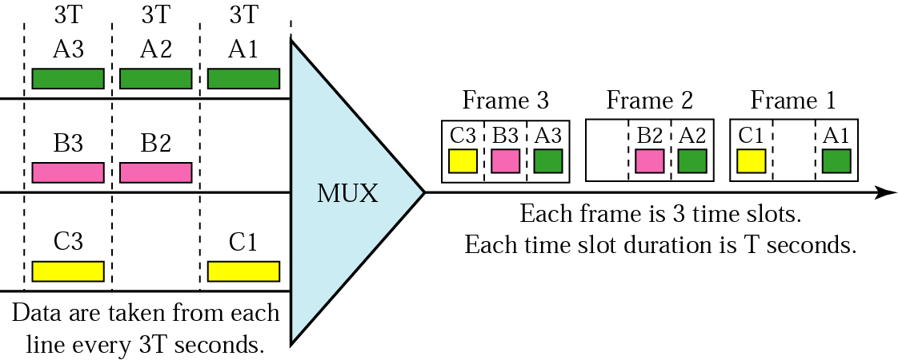
ATM multiplexing
a) Asynchronous TDM : ATM multiplexers fill a slot with a cell from any input channel that has a cell.
b) TDM

Slide 7
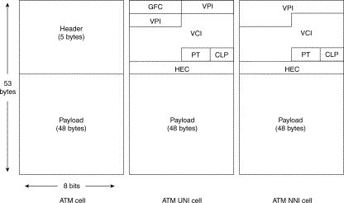
ATM Technology
ATM Frame and Header Structure

Slide 8
ATM Technology
ATM Frame and Header Structure
Generic Flow Control (GFC)
provides flow control at the UNI level
Virtual Path Identifier (VPI)
identifies the cell’s next VP to pass through a series of network.
Virtual Channel Identifier (VCI)
Identifies the cell’s next VC inside the VP.
Payload Type (PT)
The first bit indicates whether the cell contains user data (bit 0) or control data (bit 1).
The second bit indicates congestion (0 = no congestion, 1 = congestion), and
The third bit indicates whether the cell is the last in a series of cells (1 = last cells for the frame)
Cell Loss Priority (CLP)
Indication if the cell should be discarded if it encounters extreme congestions as it moves through
the network (bit 1 = discarded in referenced to cells with CLP equal to 0)
Header Error Control (HEC)
Calculates checksum only on the first 4 bytes of the header. HEC can detect error and correct a single
bit error in these bytes—thus preserving the cell rather than discarding it.

